Slide 1
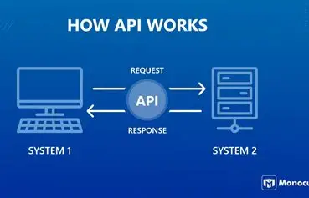
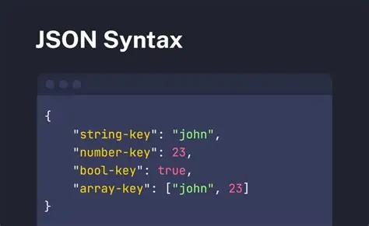
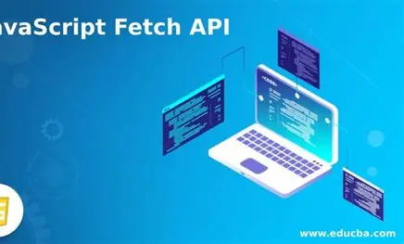
APIs, Fetch, and HTTP Requests
Research + Visual Project
Joshua Xie
This project explains:
• What APIs are
• What JSON is
• How Fetch works
• GET, POST, and PUT requests
API
JSON
Fetch

Slide 2
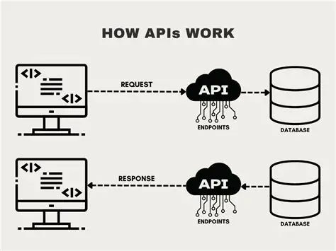
What is an API?
An API lets two programs talk to each other.
One program asks for data.
The other sends it back.
Example:
A weather app asks for the weather.
The server sends the result.
My understanding:
API is like a bridge.
API helps systems talk and share data

Slide 3
What is JSON?
JSON is a simple way to store and send data.
It is just text, not code.
Data is written in key and value pairs.
Example:
name: "Joshua"
age: 20
My understanding:
JSON is just data.
{
"name": "Joshua",
"age": 20,
"course": "IT Programming"
}
JSON shows data in a clear structure

Slide 4
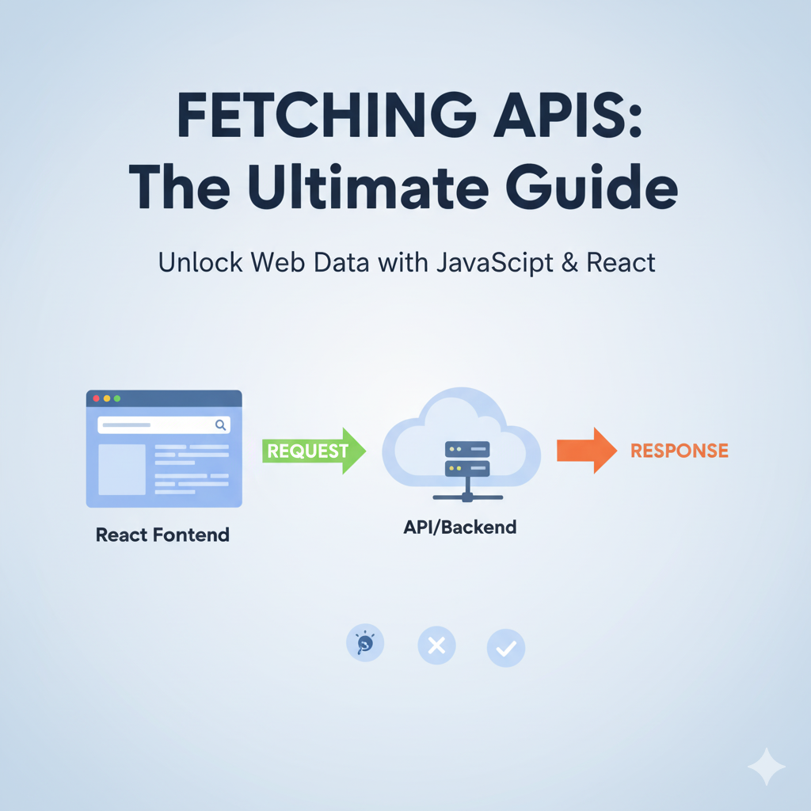
What is Fetch API?
Fetch is used to send requests to a server.
It can get data or send data.
It works with APIs.
Example:
A website gets data from a server.
My understanding:
Fetch is how JavaScript talks to a server.

Slide 5
What is a GET request?
GET is used to get data from a server.
It does not change data.
Example: Get a list of users from a server.
My understanding:
GET is used to read data.
fetch(...) sends a request to the server
response.json() reads the JSON data
console.log(data) shows the result
fetch("https://example.com/data")
.then(response => response.json())
.then(data => console.log(data));

Slide 6
What is a POST request?
POST is used to send data to a server.
It is used to create new data.
Example: Send a new user to the server.
My understanding:
POST is used to send new data.
fetch("https://example.com/data", {
method: "POST",
headers: {
"Content-Type": "application/json"
},
body: JSON.stringify({ name: "Joshua" })
});
method: "POST" means sending data
headers tell the server the data is JSON
body contains the data being sent
JSON.stringify() turns data into JSON text

Slide 7
What is a PUT request?
PUT is used to update data on a server.
It replaces existing data.
Example: Update a user's name.
My understanding:
PUT is used to change data.
fetch("https://example.com/data/1", {
method: "PUT",
headers: {
"Content-Type": "application/json"
},
body: JSON.stringify({ name: "New Name" })
});
method: "PUT" means updating data
headers tell the server the data is JSON
body contains the new data
JSON.stringify() turns data into JSON text

Slide 8
GET, POST, and PUT
GET is used to get data.
POST is used to send new data.
PUT is used to update data.
My understanding:
GET reads, POST creates, and PUT updates.
Request | What it does | Simple
GET | Gets data | Read
POST | Sends new data | Create
PUT | Updates data | change
These requests help websites communicate with servers.

Slide 9
References
MDN Web Docs – API, JSON, Fetch, HTTP Methods W3Schools – Fetch API and HTTP Requests
Thank you!

